Slide 1
CS 447/647
init

Slide 2
Overview
What is init?
What are units?
Exercises

Slide 3
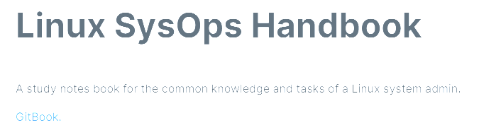


Slide 4
Virtual Machine Boot (Recap)
BIOS or UEFI
Bootloader (GRUB)
Kernel and initramfs
initramfs init (shell script)
systemd init
Notes:
Kernel unpacks initramfs into memory
Executes /sbin/init
Init creates /proc /sys /dev
/dev is for special devices, block devices, character devices (GPU, audio card, serial port ttys0, etc.)
/proc is runtime environment of the kernel (running processes, environment, file descriptor table - stdin, stdout, stderr)
/sys is an interface for kernel objects / devices
pivot_root, then executes systemd

Slide 5
What is init?

Slide 6
init
Short for initialization
First process to run
PID 1
Query processes with the ps(1) command: ps -q 1
/sbin/init > /lib/systemd/systemd
Three types
SysV - System 5, Just a bunch of shell scripts (Legacy). 1983
BSD - Just like Sys5 but for the Berkeley Software Distribution
systemd - Replaces SysV. used on nearly all modern Linux distributions
Notes:
Debian voted to change from SysV to systemd in 2014
SysV is called System 5 because it was part of AT&T’s fifth official UNIX release
Lift the BSD-style "only yourself" restriction
Lift the BSD-style "must have a tty" restriction

Slide 7
Why you need to know SysV
Legacy systems
CentOS 5 and older
Debian used it before 2014
Ubuntu is downstream of Debian
“The only reason why we still use it today is the cost of a migration.”

Slide 8
SysV init - Runlevels
Modes of operation
0 Shutdown
1 Single user mode - AKA Recovery
2-5 Normal multi-user mode - Most things run here, Networking, Graphics
6 Reboot

Slide 9
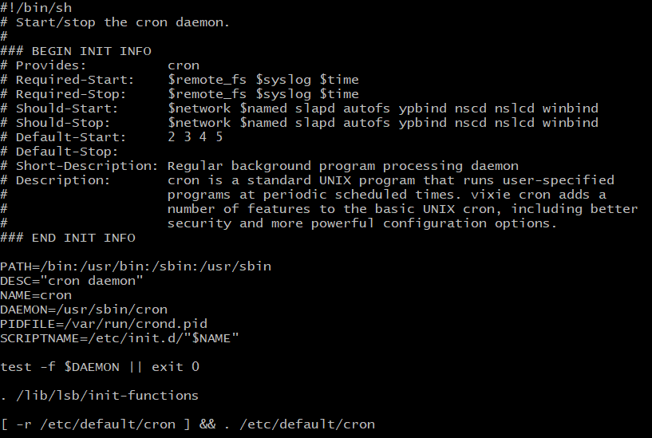
Notes:
Tedious to maintain and difficult to debug
If you thought the bash in assignment 2 was difficult wait till you have to deal with Sys5 scripts
start
start the service
stop
stop the service
restart
stop and restart the service if the service is already running, otherwise start the service
try-restart
restart the service if the service is already running
reload
cause the configuration of the service to be reloaded without actually stopping and restarting the service
force-reload
cause the configuration to be reloaded if the service supports this, otherwise restart the service if it is running
status
print the current status of the service
http://refspecs.linuxfoundation.org/LSB_3.1.0/LSB-Core-generic/LSB-Core-generic/initscrcomconv.html

Slide 10
SysV init issues
Not parallel
Issues with dependencies
Different conventions\code
Difficult to maintain

Slide 11
systemd init
Standardize system services management
Collection of programs, daemons, libraries, technologies and kernel components
systemctl - Manages units
journalctl - Logging
networkd - Network Configuration
loginctl - Login manager
hostnamectl - Control the system hostname
In short, it starts stuff.
Notes:
Journalctl compresses logs
To describe it in a generic way, the Systemd System and Service Manager is used to start stuff.
The stuff is referred to as units. Units can be many things.
One of the most important unit types is the service.
Typically, services are processes that provide specific functionality and allow connections from external clients coming in, such as the SSH service, the Apache web service, and many more.
Apart from services, other unit types exist, such as socket, mount, and target. To display a list of available units, type systemctl -t help (see Example 11-1).

Slide 12
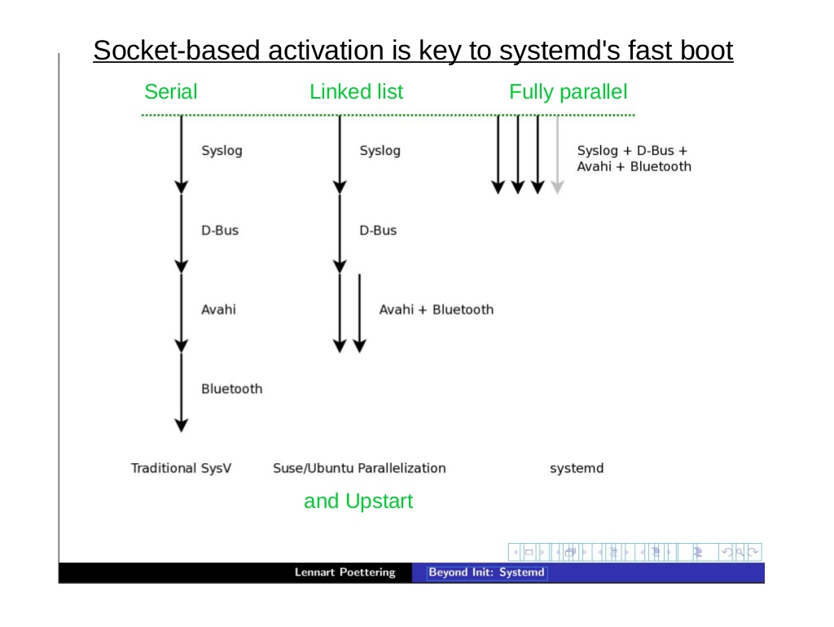
Notes:
Why was it developed?
Aggressive parallelization
Configuration oriented
SysV was breaking a core Unix principle don’t be clever in code. Store things in a configuration

Slide 13
systemd.unit
Unit - entity managed by systemd
Service - Most common
Socket - Interprocess Communication (IPC)
Timer - Time-based process
Mount - Filesystem mounting
Target - Group of Units
Scope - Group of processes
Slice - Resources for a group of processes
Path - A path monitored by systemd
Whatever else Lennart Poettering implements
systemctl --type help
systemctl list-units #Shows all units
Notes:
Services - ssh, apache, dhcp
SystemD timer won’t replicate
Target replaces runlevels (group of units)
Scope
Slice - set of resources for a scope

Slide 14
Managing a systemd unit
vsftpd - lightweight, efficient FTP server written for security
Type apt install -y vsftpd to Install the Very Secure FTP Server
Type systemctl start vsftpd to activate the FTP server on your machine.
Type systemctl status vsftpd. You’ll get output where you can see that the vsftpd service is currently operational.
Type systemctl disable vsftpd to stop the service from starting at boot.
Type systemctl enable vsftpd to automatically start the service after a restart.

Slide 15
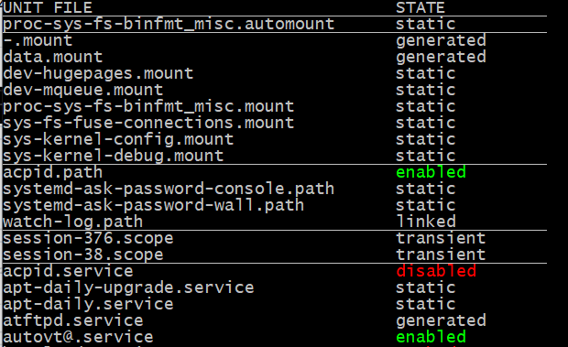
systemd.unit
systemctl list-unit-files
Notes:
generated mount units come from the fstab

Slide 16
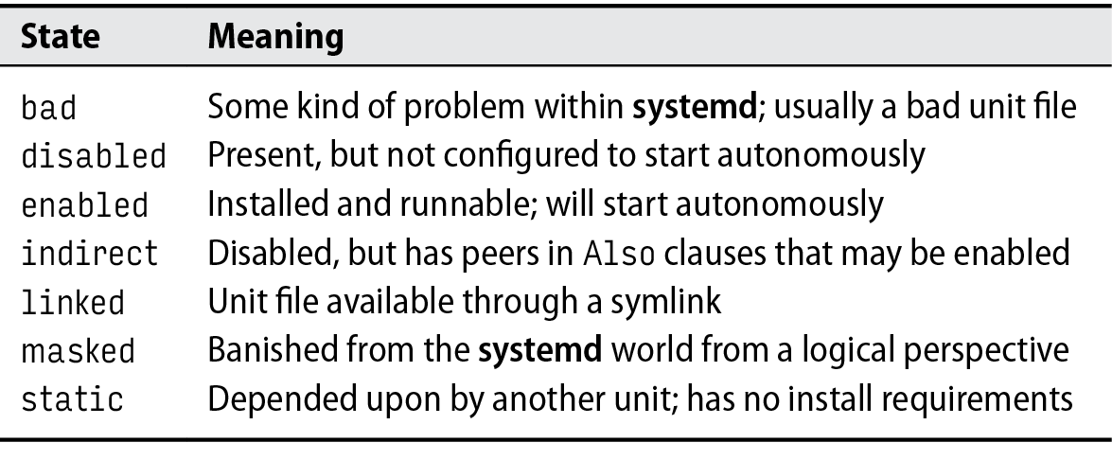
systemd.unit states

Slide 17
systemd.target
Similar to runlevels
Groups units together
Important targets
multi-user.target: day-to-day use server
graphical.target: day-to-day use desktop
emergency.target: used for recovery
rescue.target: used for single-user mode
systemctl --type target #Show all targets systemctl list-dependencies multi-user.target #Show dependencies systemctl get-default #Display the default target systemctl set-default multi-user.target #Set the default target systemctl isolate reboot.target #Start these units and stop others

Slide 18
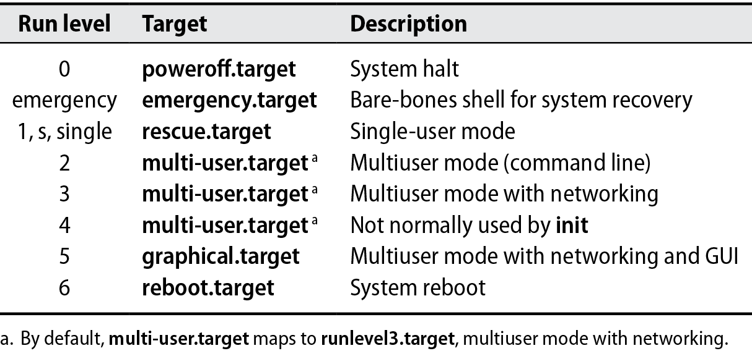

Slide 19
Unit locations
/usr/lib/systemd/system
Contains default unit files that have been installed from packages. You should never edit these files directly.
/etc/systemd/system contains custom unit files.
It may also contain files that have been written by an administrator or generated by the systemctl edit command.
/run/systemd/system
Contains unit files that have automatically been generated.
SYSTEMD_UNIT_PATH env variable
Has to exist before /sbin/init is executed.
$SYSTEMD_UNIT_PATH ends with an empty component (":"), the usual unit load path will be appended to the contents of the variable.

Slide 20
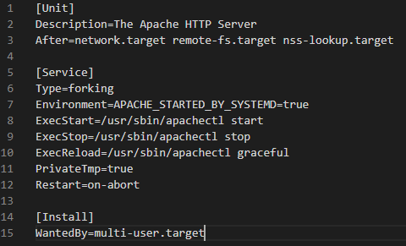
man 5 systemd.service
Notes:
[Unit] Describes the unit and defines dependencies
The Before statement indicates that this unit should be started before the unit that is specified.
The After statement indicates that this unit should be started after the unit that is specified.
[Service] Describes how to start and stop the service and request status installation.
ExecStart line is expected
The forking type is commonly used by daemon processes, but you can also use other types, such as oneshot, which will start any command from a Systemd unit.
man 5 systemd.service
[Install] Indicates in which target this unit has to be started.

Slide 21
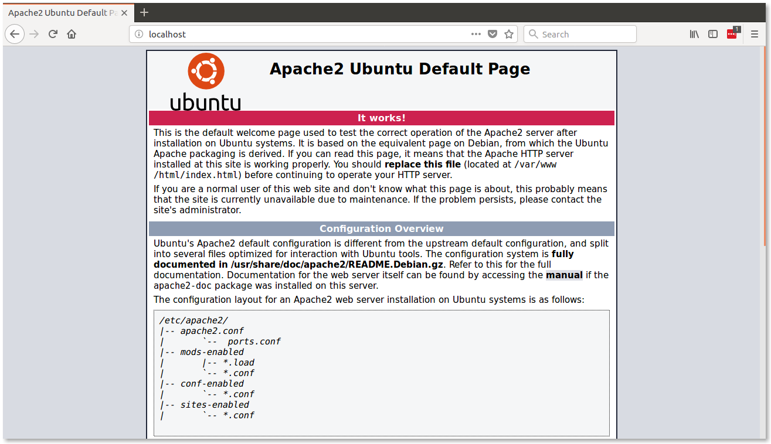

Slide 22
Changing a unit configuration
Type apt install nginx-extras to install the nginx web server package.
Type systemctl cat nginx.service to show the current configuration of the unit file that starts the nginx web server.
Type systemctl show nginx.service to get an overview of available configuration options for this unit file.
Type systemctl edit nginx.service to change the default configuration, and ensure that the [Service] section includes the lines Restart=always and RestartSec=5s.
Type systemctl daemon-reload to ensure that systemd picks up the new configuration.
Type systemctl restart nginx to restart the nginx service.
Type systemctl status nginx and then repeat after 5 seconds. You’ll notice that the nginx process gets automatically restarted.
export SYSTEMD_EDITOR=”/usr/bin/vim” #Changes the editor

Slide 23
Testing “Restart=always”
View the process ps ax | grep nginx #or ps -fp $(pgrep -d, -x nginx) #pgrep finds the process by name
Kill the process with a signal pkill -SIGTERM -f nginx
Wait 5 seconds… then check if it’s running ps ax | grep nginx
Check status systemctl status nginx
Notes:
a - only yourself
x - outside of tty
p - by PID
f - Do full-format listing.
UID PID PPID C STIME TTY TIME CMD
PPID - parent process
C = CPU utilization
STIME - Start time
TIME = accumulated CPU time in MMM:SS

Slide 24
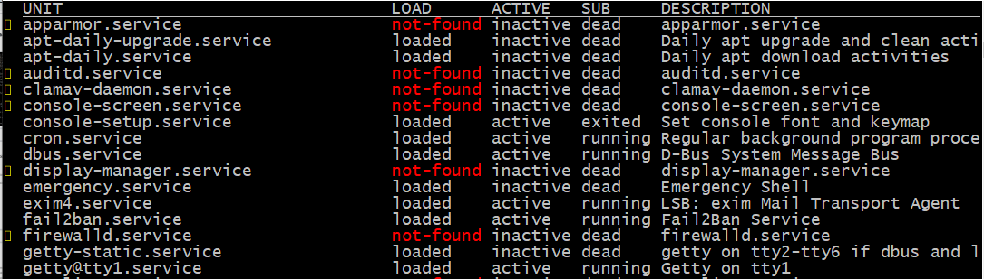
service
systemctl --type=service --all
Notes:
UNIT: The systemd unit name
LOAD: Whether the unit’s configuration has been parsed by systemd. The configuration of loaded units is kept in memory.
ACTIVE: A summary state about whether the unit is active. This is usually a fairly basic way to tell if the unit has started successfully or not.
SUB: This is a lower-level state that indicates more detailed information about the unit. This often varies by unit type, state, and the actual method in which the unit runs.
DESCRIPTION: A short textual description of what the unit is/does.

Slide 25
Minecraft .service
apt install unzip mkdir /srv/minecraft cd /srv/minecraft/ wget https://minecraft.azureedge.net/bin-linux/bedrock-server-1.16.40.02.zip unzip bedrock-server-1.16.40.02.zip #Test it ./bedrock_server

Slide 26
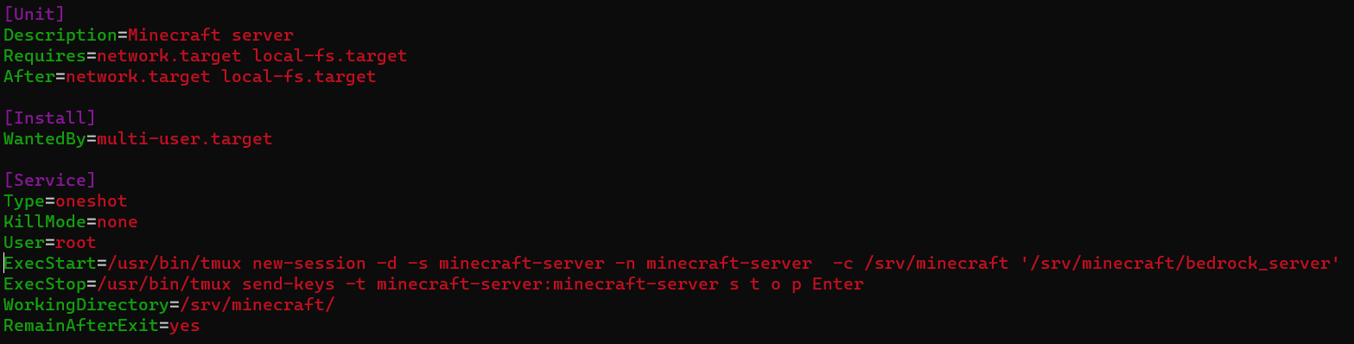
.service file

Slide 27
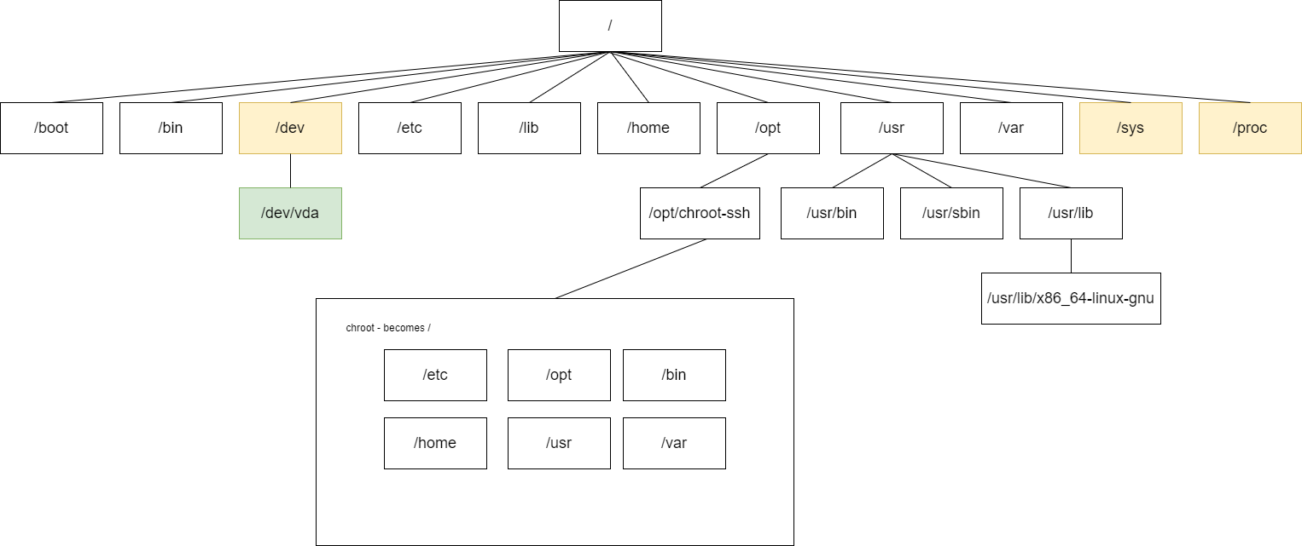
chroot-ssh
Create a separate SSH service
Limit filesystem access
Untrustworthy users
Limit userland commands

Slide 28
chroot-ssh
lxc config device add c0 proxy22 proxy listen=tcp:0.0.0.0:2222 connect=tcp:127.0.0.1:22

Slide 29
socket
A unit file that ends in “.socket”
Unix Socket or Network Socket
A unix socket is a file
Network socket is an Internet Protocol (IP) address and a port. 127.0.0.01:4444
Inter-Process Communication
Needs three sections
[Unit]
[Install]
[Socket]
Notes:
For each socket unit, a matching service unit must exist

Slide 30
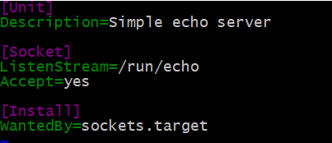
/etc/systemd/system/echo.socket
systemctl list-unit-files | grep socket
Notes:
If yes, a service instance is spawned for each incoming connection and only the connection socket is passed to it. If false, all listening sockets themselves are passed to the started service unit, and only one service unit is spawned for all connections

Slide 31
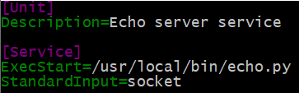
/etc/systemd/system/echo@.service
systemctl list-unit-files | grep “echo@”
Notes:
Generous font size

Slide 32
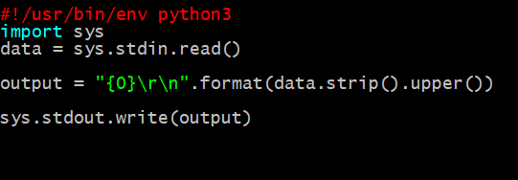
/usr/local/bin/echo.py
Create a file:
apt install -y socat chmod +x /usr/local/bin/echo.py echo “test” | echo.py # Output: TEST
Notes:
Add execute permissions

Slide 33
Let’s use our echo.socket
systemctl daemon-reload
systemctl list-unit-files | grep echo
systemctl start echo.socket
apt install -y socat # Used for communicating with a Unix socket
echo hello world | socat - unix-connect:/run/echo

Slide 34
timer
A unit file that ends in “.timer” that runs a service
Built-in support for
Calendar Time, IE: OnCalendar=Mon *-*-* 00:00:00
Monotonic Time Events, IE: OnBootSec, OnStartupSec
Transient
systemd-run --on-active=30 /bin/touch /tmp/foo
Needs three sections
[Unit]
[Install]
[Timer]
Notes:
A monotonic clock is a time source that won't ever jump forward or backward

Slide 35
timer - OnCalendar Examples
DayOfWeek Year-Month-Day Hour:Minute:Second
minutely → *-*-* *:*:00 hourly → *-*-* *:00:00 daily → *-*-* 00:00:00 monthly → *-*-01 00:00:00 weekly → Mon *-*-* 00:00:00 yearly → *-01-01 00:00:00 quarterly → *-01,04,07,10-01 00:00:00 semiannually → *-01,07-01 00:00:00
systemd-run -d --user --on-calendar '2022-02-22 23:59:00 PST' some-command
Notes:
Daily and hourly for backups

Slide 36
timer - OnCalendar Examples
#First Saturday of each month Sat *-*-1..7 18:00:00 #Monday through Friday 10:30PM Mon..Fri 22:30
#Run the first 4 days of a Month only if Mon or Tue Mon,Tue *-*-01..04 12:00:00
#Run these systemd-analyze calendar '*-*-* 20:00:0' systemd-analyze calendar 'Mon,Tue *-*-01..04 12:00:00'

Slide 37
/etc/systemd/system/backup@.service
[Unit] Description=Performs a system backup
[Service] Type=oneshot ExecStart=/usr/local/bin/backup.sh

Slide 38
/etc/systemd/system/backup@%i.timer
[Unit] Description=Run a backup at %i interval
[Timer] OnCalendar=%i Persistent=true
[Install] WantedBy=timers.target

Slide 39
/usr/local/bin/backup.sh
#!/bin/bash
DATE_STR=`date +'%d_%m_%Y_%H_%M'` echo "Backup Script ${DATE_STR}"
# Test in with bash..
chmod +x /usr/local/bin/backup.sh /usr/local/bin/backup.sh #Test it

Slide 40
timer
systemctl start backup@hourly.timer systemctl status backup@hourly.timer
systemctl list-timers systemctl start backup@hourly.service systemctl status backup@hourly.service
#Transient Timer Example systemd-run --on-active=30 /usr/local/bin/backup.sh

Slide 41
mount - Filesystem Mountpoint
#/etc/systemd/system/cs447.mount [Unit] Description=Server CS447 directory After=network.target
[Mount] What=192.168.1.1:/cs447 Where=/cs447 Type=nfs Options=_netdev,auto
[Install] WantedBy=multi-user.target

Slide 42
systemd logging
journald
Handles logging from the kernel and all services from the early boot process (initramfs) to final shutdown
Messages are stored in /run
rsyslog can forward them to /var/log
Common Commands SYSTEMD_LOG_LEVEL=debug #Environmental variable for debugging journalctl -n 20 #Last 20 lines journalctl -u echo.socket journalctl -f -u echo.socket #Follow the log, similar to tail -f journalctl /usr/local/bin/echo.py #All lines from echo.py
Notes:
/etc/systemd/journald.conf
[Journal]
Storage=Persistent

Slide 43
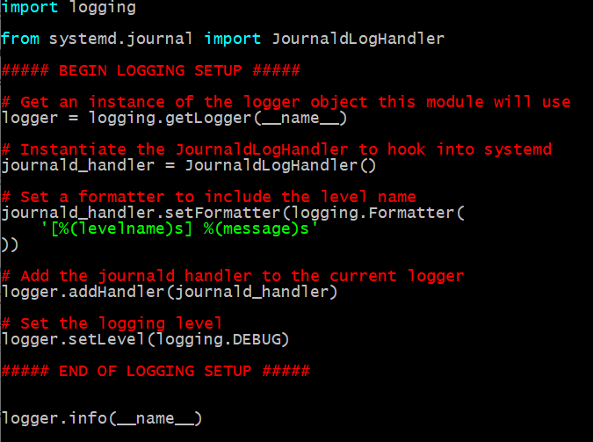

Slide 44
Exercise
Tar file inspecting socket
Pipe a tar file to the socket.
The socket sends the input to list_tar.py,
list_tar.py iterates over the TarInfo objects and prints their names.
Need .socket and .service files
cp /cs447/demos/systemd/list_tar-socket/list_tar.py.start ~/ cp /cs447/demos/systemd/list_tar-socket/troff_files.tar ~/ mv list_tar.py /usr/local/bin/list_tar.py cat troff_files.tar | list_tar.py cat troff_files.tar | socat - unix-connect:/run/list_tar #UDS

